Slide 1
雲端計算
Cloud Computing
Server Virtualization

Slide 2
Agenda
Virtualization Technique
  CPU Virtualization
    Emulation techniques
    Trap and emulate model
    Hardware assistance
  Memory Virtualization
    Shadow page table
    Hardware assistance
  IO Virtualization
    Overview
    Device model
    Hardware assistance
Ecosystem
  VMware
  Xen
  KVM
Other Issues
  Live migration
  Cloud properties

Slide 3
CPU Virtualization
Emulation techniques
Trap and emulate paradigm
Hardware assistance

Slide 4
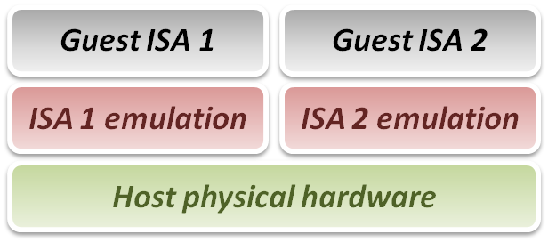
Emulation Technique
Why do we talk about emulation ?
  In fact, virtualization technique can be treated as a special case of emulation technique.
  Many virtualization techniques were developed in or inherited from emulation technique.
Goal of emulation :
  Provide a method for enabling
  a (sub)system to present the
  same interface and characteristics
  as another.

Slide 5
Emulation Technique
Three emulation implementations :
  Interpretation
    Emulator interprets only one instruction at a time.
  Static Binary Translation
    Emulator translates a block of guest binary at a time and further optimizes for repeated instruction executions.
  Dynamic Binary Translation
    This is a hybrid approach of emulator, which mix two approaches above.
Design challenges and issues :
  Register mapping problem
  Performance improvement

Slide 6
Interpretation
Interpreter execution flow :
  Fetch one guest instruction from guest memory image.
  Decode and dispatch to corresponding emulation unit.
  Execute the functionality of that instruction and modify some related system states, such as simulated register values.
  Increase the guest PC (Program Counter register) and then repeat this process again.
Pros & Cons
  Pros
    Easy to implement
  Cons
    Poor performance

Slide 7
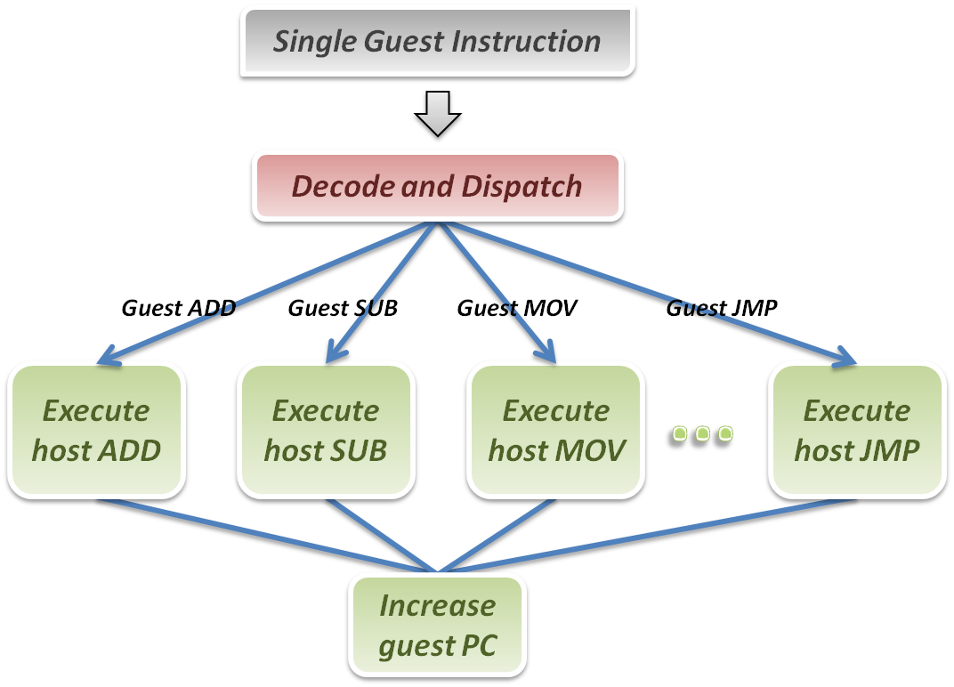
Interpretation
Interpreter

Slide 8
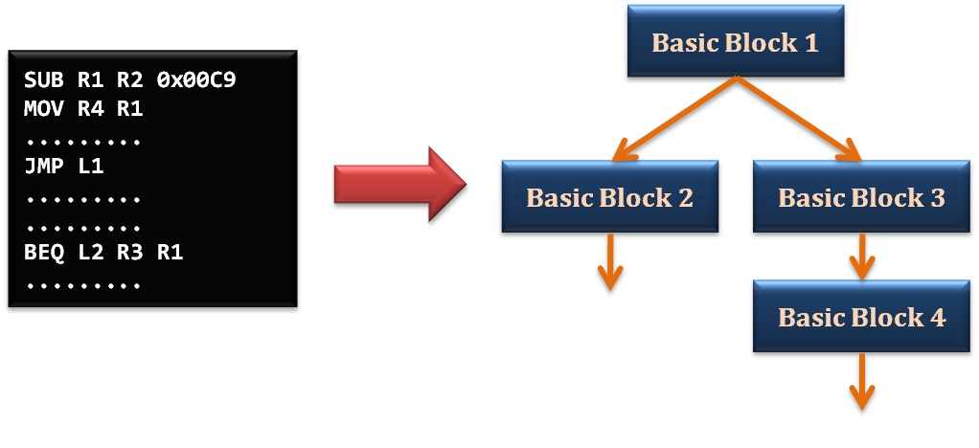
Static Binary Translation
Using the concept of basic block which comes from compiler optimization technique.
  A basic block is a portion of the code within a program with certain desirable properties that make it highly amenable to analysis.
  A basic block has only one entry point, meaning no code within it is the destination of a jump instruction anywhere in the program.
  A basic block has only one exit point, meaning only the last instruction can cause the program to begin executing code in a different basic block.

Slide 9
Static Binary Translation
Static binary translation flow :
  Fetch one block of guest instructions from guest memory image.
  Decode and dispatch each instruction to the corresponding translation unit.
  Translate guest instruction to host instructions.
  Write the translated host instructions to code cache.
  Execute the translated host instruction block in code cache.
Pros & Cons
  Pros
    Emulator can reuse the translated host code.
    Emulator can apply more optimization when translating guest blocks.
  Cons
    Implementation complexity will increase.

Slide 10
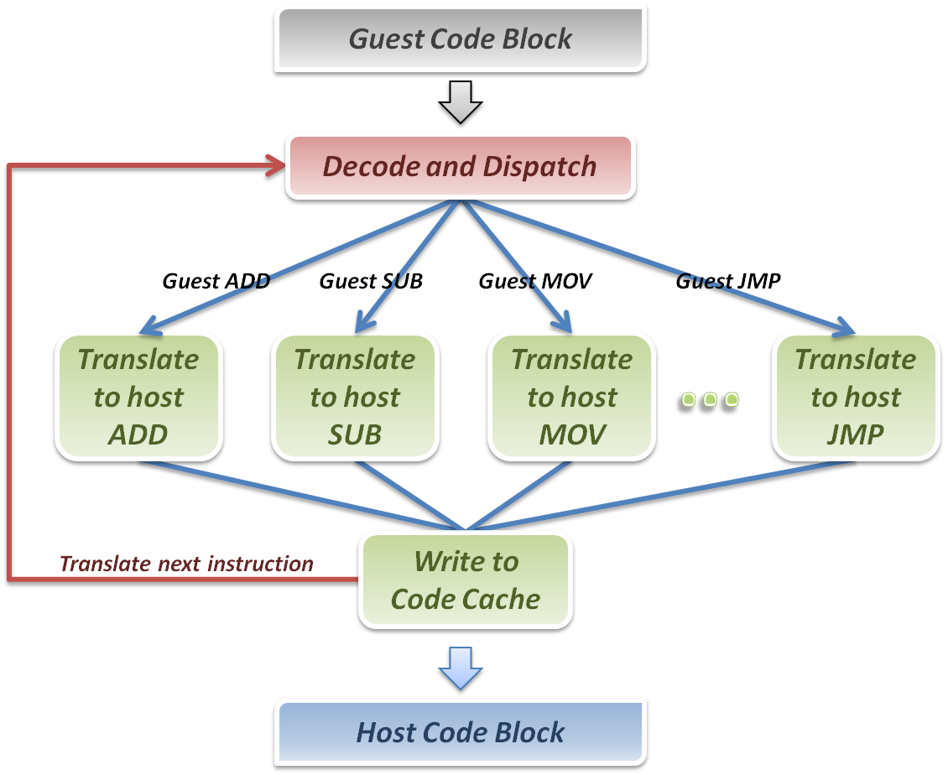
Binary Translation
Binary Translator

Slide 11
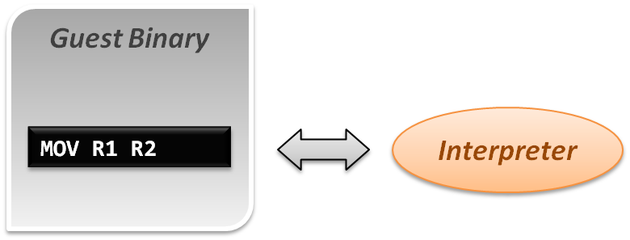
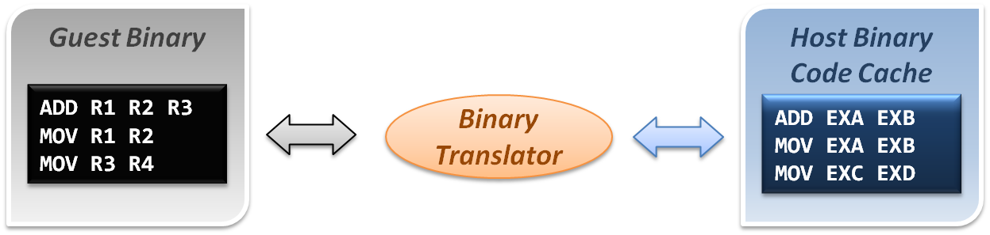
Comparison
Interpretation implementation
Static binary translation implementation

Slide 12
Dynamic Binary Translation
A hybrid implementation
  For the first discovered codes, directly interpret by interpreter and record these codes as discovered.
  As the guest codes discovered, trigger the binary translation module to translate the guest code blocks to host code blocks, and place them into code cache.
  When execute the translated block of guest code next time, jump to the code cache and execute the translated host binary code.
Pros & Cons
  Pros
    Transparently implement binary translation.
  Cons
    Hard to implement.

Slide 13
Dynamic Binary Translation
First time execution, no translated code in code cache.
Miss code cache matching, then directly interpret the guest instruction.
As a code block discovered, trigger the binary translation module.
Translate guest code block to host binary, and place it in the code cache.
Next time execution, run the translated code clock in the code cache.
Binary Translator
Guest Binary
trigger
Host Binary Code Cache
Emulation Manager
hit
exit
return
miss
Interpreter

Slide 14
Design challenges and issues
Register mapping problem
Performance improvement

Slide 15
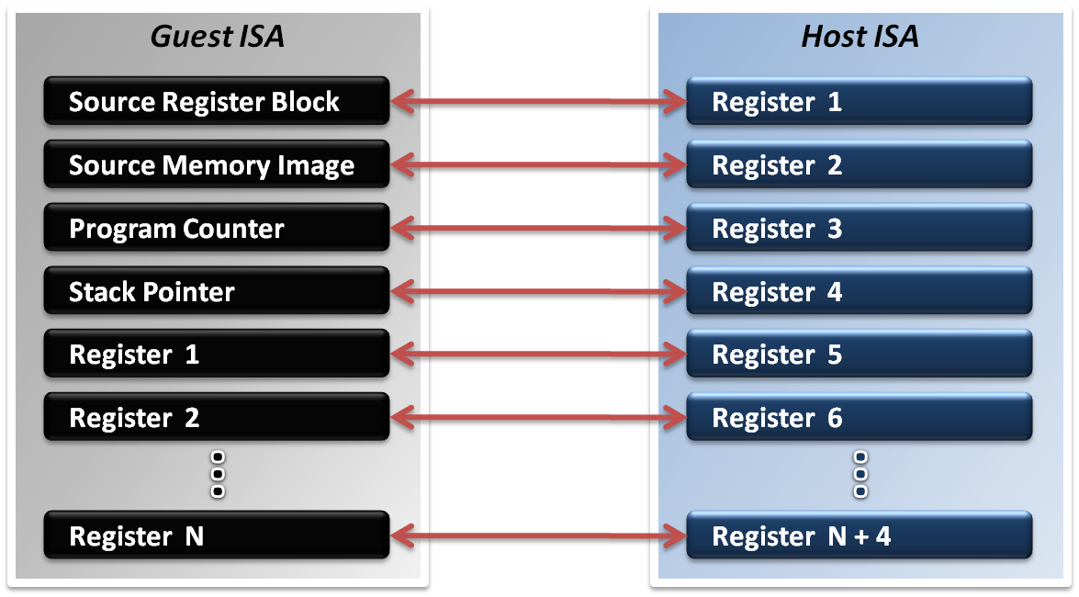
Register Mapping Problem
Why should we map registers ?
  Different ISA will define different number of registers.
  Sometimes guest ISA even require some special purpose register which host ISA does not defined.

Slide 16
Register Mapping Problem
Mapping different purpose of registers :
  Map special purpose registers
    Program Counter Register
    Stack Pointer Register
    Page Table Register
    System Statues Register
    Special Flags Register
  Hold guest context and memory image
  Map general purpose registers
  Map intermediate values

Slide 17
Register Mapping Problem
If number of host registers is larger the guest
  That will be an easier case for implementation.
  Directly map one register of guest to one of host, and make use of the rest registers for optimization.
  Example :
    Translating x86 binary to RISC
If number of host registers is not enough
  That should involve more effort.
  Emulator may only map some frequently used guest registers to host, and left the unmapped registers in memory.
  Mapping decision will be critical in this case.

Slide 18
Performance Improvement
What introduces the performance hit ?
  Control flow problem
    Highly frequent context switches between code caches and emulation manager will degrade performance.
  Target code optimization
    Translate guest code block in instruction-wise (translate one instruction at a time) will miss many optimization opportunities.
Solutions :
  Translation Chaining
  Dynamic Optimization

Slide 19
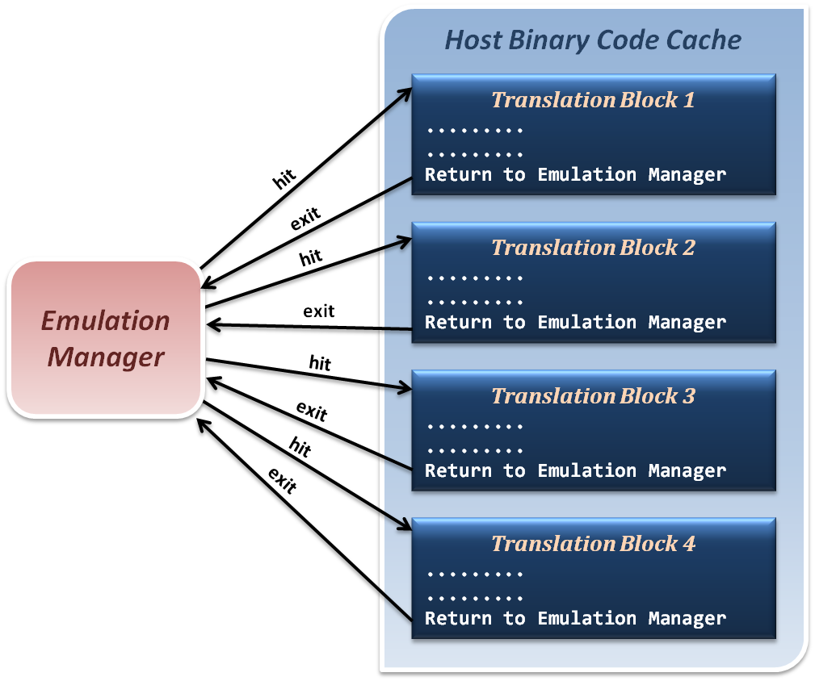
Translation Chaining
Non-optimized control flow
between translated blocks and
emulation manager.
Context Switches

Slide 20
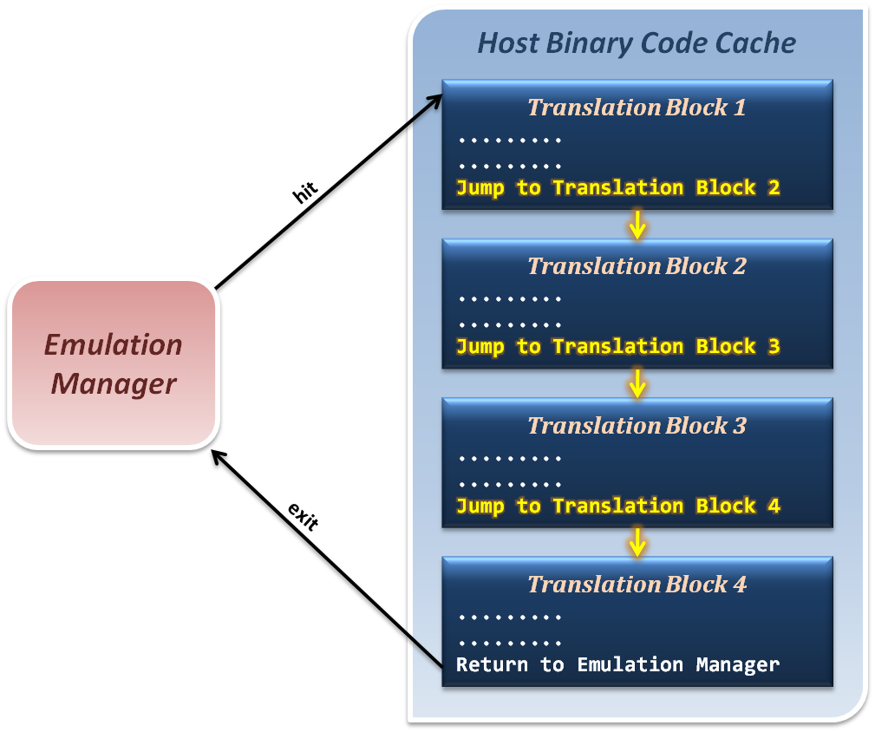
Translation Chaining
Jump from one translation directly to next, which avoid switching back to emulation manager.

Slide 21
Dynamic Optimization
How to optimize binary codes ?
  Static optimization (compiling time optimization)
    Optimization techniques apply to generate binary code base on the semantic information in source code.
  Dynamic optimization (run time optimization)
    Optimization techniques apply to generated binary code base on the
    run time information which relate to program input data.
Why we use dynamic optimization technique ?
  Advantages :
    It can benefit from dynamic profiling.
    It is not constrained by a compilation unit.
    It knows the exact execution environment.

Slide 22
Dynamic Optimization
How to implement dynamic optimization ?
  Analysis program behavior in run time.
  Collect run time profiling information based on the input data and host hardware characteristics.
  Dynamically translate or modify the binary code by reordering instructions or other techniques.
  Write back the optimized binary into code cache for next execution.

Slide 23
Dynamic Optimization
How to analyze program behavior and profile ?
  Collect statistics about a program as it runs
    Branches (taken, not taken)
    Jump targets
    Data values
    Cache misses
  Predictability allows these statistics to be used for optimizations to be used in the future
Profiling in a VM differs from traditional profiling used for compiler feedback.

Slide 24
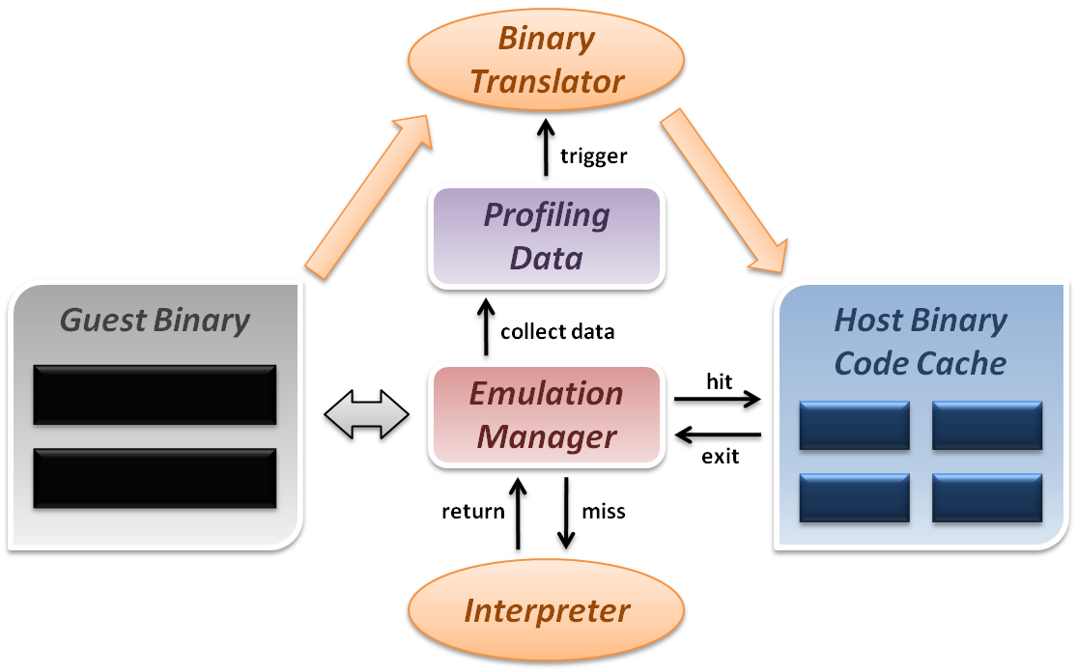
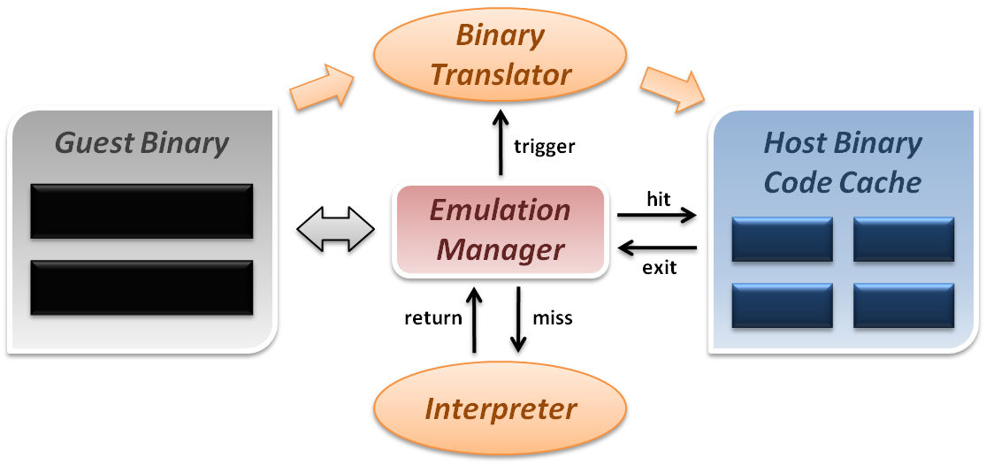
Dynamic Optimization
Dynamic binary translation and optimization :

Slide 25
CPU Virtualization
Emulation techniques
Trap and emulate model
Hardware assistance

Slide 26
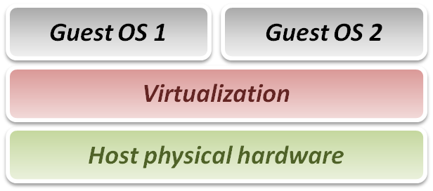
Virtualization Technique
From emulation to virtualization :
  While emulation techniques emulate guest on host, whose ISA differ from guest, in virtualization techniques, guest and host have the same ISA.
  Some problems in emulation will not exist in virtualization :
    No need to translate each binary instruction to host ISA.
    No need to worry about unmatched special register mapping.
  Some new problems didn’t exist in emulation exist now :
    Instruction privileges should be well-controlled.
Goal of virtualization :
  Run or simulate all instructions
  of guest OS.

Slide 27
Virtualization Technique
Virtualization requirements from Popek and Goldberg :
  Popek and Goldberg provide a set of sufficient conditions for a computer architecture to efficiently support system virtualization.
  Popek and Goldberg provide guidelines for the design of virtualized computer architectures.
In Popek and Goldberg terminology, a VMM must present all three properties :
  Equivalence (Same as real machine)
  Resource control (Totally control)
  Efficiency (Native execution)

Slide 28
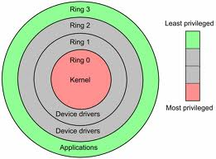
CPU Architecture
Modern CPU status is usually classified as several modes.
In general, we conceptually divide them into two modes :
  Kernel mode (Ring 0)
    CPU may perform any operation allowed by its architecture, including any instruction execution, IO operation, area of memory access, and so on.
    Traditional OS kernel runs in Ring 1 mode.
  User mode (Ring 1 ~ 3)
    CPU can typically only execute a subset of those available instructions in kernel mode.
    Traditional application runs in Ring 3 mode.

Slide 29
CPU Architecture
By the classification of CPU modes, we divide instructions into following types :
  Privileged instruction
    Those instructions that trap if the machine is in user mode and do not trap if the machine is in kernel mode.
  Sensitive instructions
    Those instructions that interact with hardware, which include control-sensitive and behavior-sensitive instructions.
  Innocuous instruction
    All other instructions.
  Critical instruction
    Those sensitive but not privileged instructions.

Slide 30
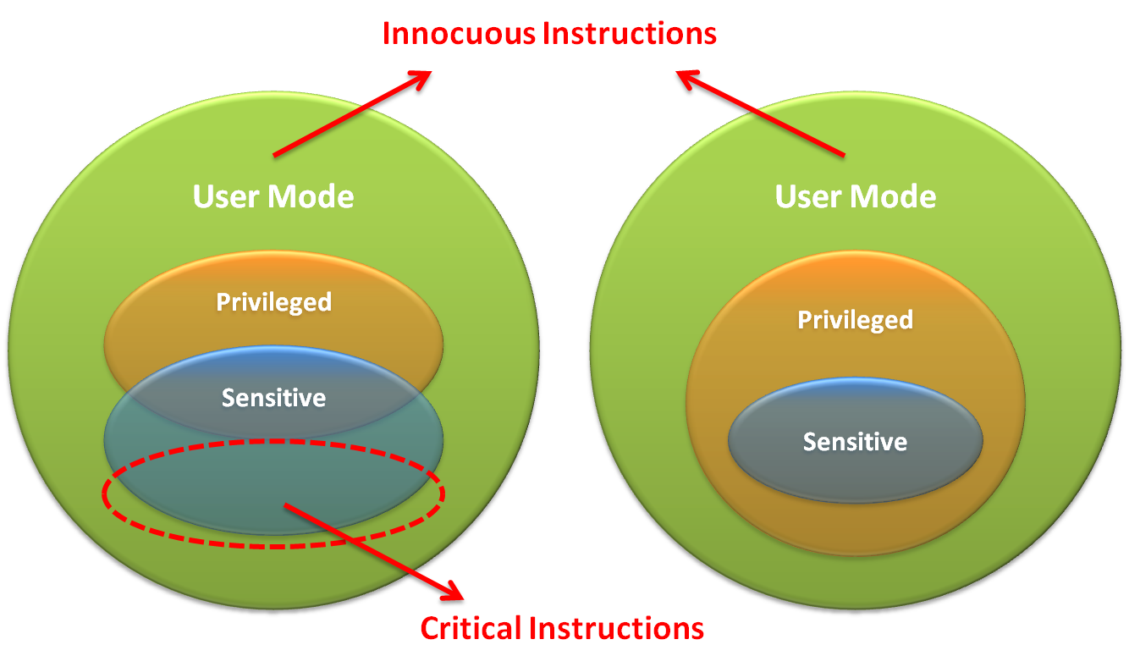
CPU Architecture

Slide 31
CPU Architecture
What is trap ?
  When CPU is running in user mode, some internal or external events, which need to be handled in kernel mode, take place.
  Then CPU will jump to hardware exception handler vector, and execute system operations in kernel mode.
Trap types :
  System Call
    Invoked by application in user mode.
    For example, application ask OS for system IO.
  Hardware Interrupts
    Invoked by some hardware events in any mode.
    For example, hardware clock timer trigger event.
  Exception
    Invoked when unexpected error or system malfunction occur.
    For example, execute privilege instructions in user mode.

Slide 32
Trap and Emulate Model
If we want CPU virtualization to be efficient, how should we implement the VMM ?
  We should make guest binaries run on CPU as fast as possible.
  Theoretically speaking, if we can run all guest binaries natively, there will NO overhead at all.
  But we cannot let guest OS handle everything, VMM should be able to control all hardware resources.
Solution :
  Ring Compression
    Shift traditional OS from kernel mode(Ring 0) to user mode(Ring 1), and run VMM in kernel mode.
    Then VMM will be able to intercept all trapping event.

Slide 33
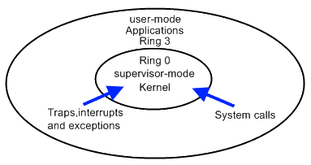
Trap and Emulate Model
VMM virtualization paradigm (trap and emulate) :
  Let normal instructions of guest OS run directly on processor in user mode.
  When executing privileged instructions, hardware will make processor trap into the VMM.
  The VMM emulates the effect of the privileged instructions for the guest OS and return to guest.

Slide 34
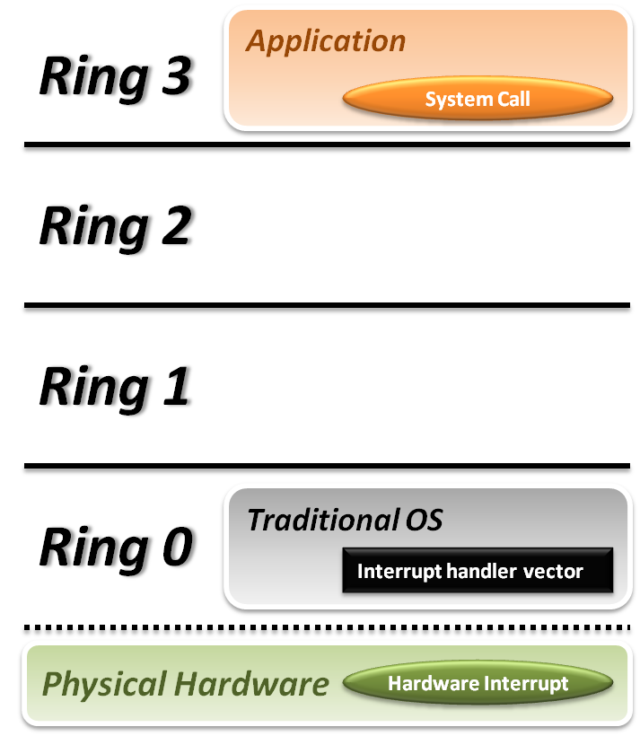


Trap and Emulate Model
Traditional OS :
  When application invoke a system call :
    CPU will trap to interrupt handler vector in OS.
    CPU will switch to kernel mode (Ring 0) and execute OS instructions.
  When hardware event :
    Hardware will interrupt CPU execution, and jump to interrupt handler in OS.

Slide 35
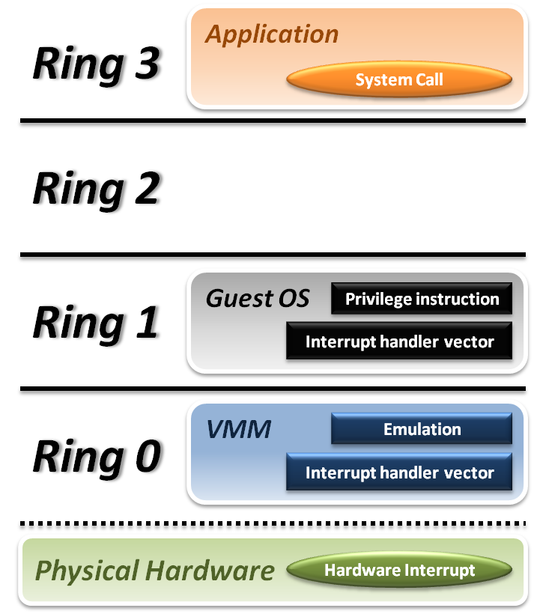






Trap and Emulate Model
VMM and Guest OS :
  System Call
    CPU will trap to interrupt handler vector of VMM.
    VMM jump back into guest OS.
  Hardware Interrupt
    Hardware make CPU trap to interrupt handler of VMM.
    VMM jump to corresponding interrupt handler of guest OS.
  Privilege Instruction
    Running privilege instructions
    in guest OS will be trapped to VMM for instruction emulation.
    After emulation, VMM jump back to guest OS.

Slide 36
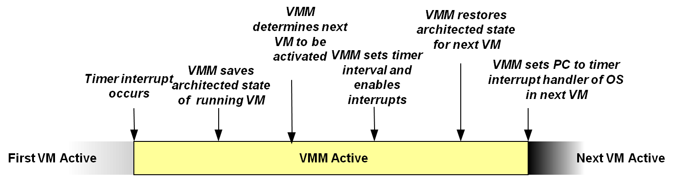
Context Switch
Steps of VMM switch different virtual machines :
  Timer Interrupt in running VM.
  Context switch to VMM.
  VMM saves state of running VM.
  VMM determines next VM to execute.
  VMM sets timer interrupt.
  VMM restores state of next VM.
  VMM sets PC to timer interrupt handler of next VM.
  Next VM active.

Slide 37
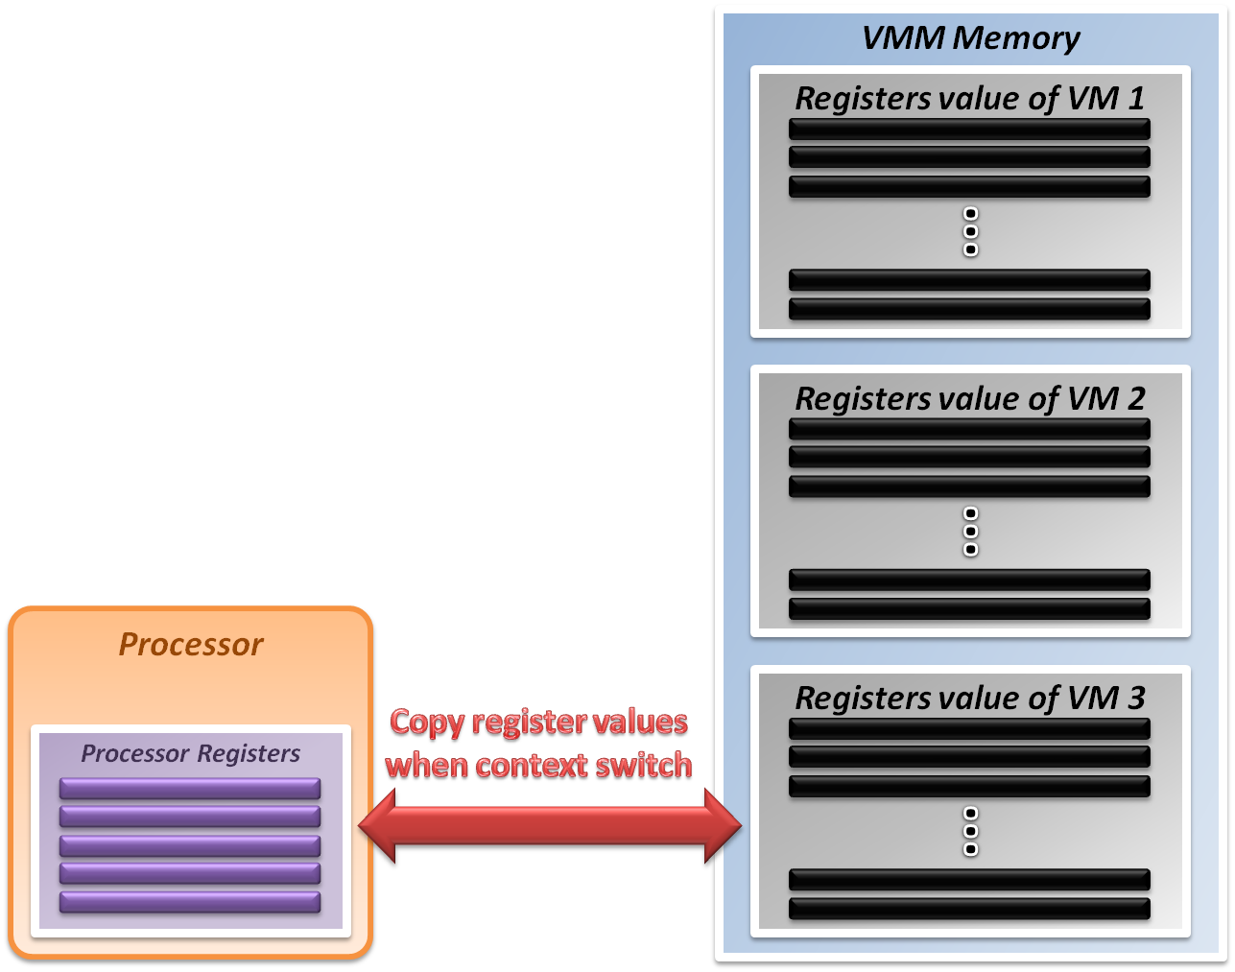
System State Management
Virtualizing system state :
  VMM will hold the system states
  of all virtual machines in memory.
  When VMM context switch from
  one virtual machine to another
    Write the register values back to memory
    Copy the register values of next guest OS to CPU registers.

Slide 38
Virtualization Theorem
Subset theorem :
  For any conventional third-generation computer, a VMM may be constructed if the set of sensitive instructions for that computer is a subset of the set of privileged instructions.
Recursive Emulation :
  A conventional third-generation computer is recursively virtualizable if
    It is virtualizable
    VMM without any timing dependencies can be constructed for it.
Under this theorem, x86 architecture cannot be virtualized directly. Other techniques are needed.

Slide 39
Virtualization Techniques
How to virtualize unvirtualizable hardware :
  Para-virtualization
    Modify guest OS to skip the critical instructions.
    Implement some hyper-calls to trap guest OS to VMM.
  Binary translation
    Use emulation technique to make hardware virtualizable.
    Skip the critical instructions by means of these translations.
  Hardware assistance
    Modify or enhance ISA of hardware to provide virtualizable architecture.
    Reduce the complexity of VMM implementation.

Slide 40
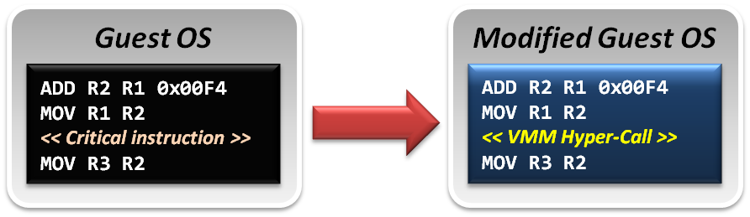
Para-Virtualization
Para-Virtualization implementation :
  In para-virtualization technique, guest OS should be modified to prevent invoking critical instructions.
  Instead of knowing nothing about hypervisor, guest OS will be aware of the existence of VMM, and collaborate with VMM smoothly.
  VMM will provide the hyper-call interfaces, which will be the communication channel between guest and host.

Slide 41
Binary Translation
In emulation techniques :
  Binary translation module is used to optimize binary code blocks, and translate binaries from guest ISA to host ISA.
In virtualization techniques :
  Binary translation module is used to skip or modify the guest OS binary code blocks which include critical instructions.
  Translate those critical instructions into some privilege instructions which will trap to VMM for further emulation.

Slide 42
Binary Translation
Static approach vs. Dynamic approach :
  Static binary translation
    The entire executable file is translated into an executable of the target architecture.
    This is very difficult to do correctly, since not all the code can be discovered by the translator.
  Dynamic binary translation
    Looks at a short sequence of code, typically on the order of a single basic block, translates it and caches the resulting sequence.
    Code is only translated as it is discovered and when possible, branch instructions are made to point to already translated and saved code.

Slide 43
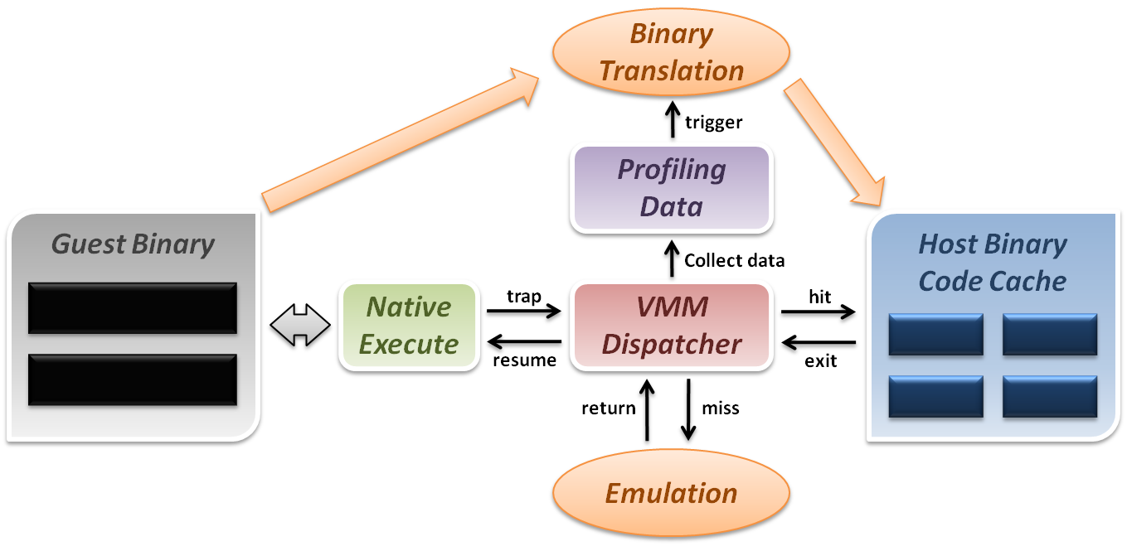
Binary Translation
Dynamic binary translation and optimization
  VMM can dynamically translate binary code and collect profiling data for further optimization.

Slide 44
Some Difficulties
Difficulties of binary translation :
  Self-modifying code
    If guest OS will modify its own binary code in runtime, binary translation need to flush the responding code cache and retranslate the code block.
  Self-reference code
    If guest code need to reference(read) its own binary code in runtime, VMM need to make it referring back to original guest binaries location.
  Real-time system
    For some timing critical guest OS, emulation environment will lose precise timing, and this problem cannot be perfectly solved yet.
Difficulty of para-virtualization :
  Guest OS modification
    User should at least has the source code of guest OS and modify its kernel; otherwise, para-virtualization cannot be used.

Slide 45
CPU Virtualization
Emulation techniques
Trap and emulate model
Hardware assistance

Slide 46
Hardware Solution
Why are there so many problems and difficulties ?
  Critical instructions do not trap in user mode.
  Even if we make those critical instructions trap, their semantic may also be changed; which is not acceptable.
In short, legacy processors did not design for virtualization purpose at the beginning.
  If processor can be aware of the different behaviors between guest and host, the VMM design will be more efficient and simple.

Slide 47
Hardware Solution
Let’s go back to trap model :
  Some trap types do not need the VMM involvement.
    For example, all system calls invoked by application in guest OS should be caught by gust OS only. There is no need to trap to VMM and then forward it back to guest OS, which will introduce context switch overhead.
  Some critical instructions should not be executed by guest OS.
    Although we make those critical instructions trap to VMM, VMM cannot identify whether this trapping action is caused by the emulation purpose or the real OS execution exception.
Solution :
  We need to redefine the semantic of some instructions.
  We need to introduce new CPU control paradigm.

Slide 48
Intel VT-x
In order to straighten those problems out, Intel introduces one more operation mode of x86 architecture.
  VMX Root Operation (Root Mode)
    All instruction behaviors in this mode are no different to traditional ones.
    All legacy software can run in this mode correctly.
    VMM should run in this mode and control all system resources.
  VMX Non-Root Operation (Non-Root Mode)
    All sensitive instruction behaviors in this mode are redefined.
    The sensitive instructions will trap to Root Mode.
    Guest OS should run in this mode and be fully virtualized through typical “trap and emulation model”.

Slide 49
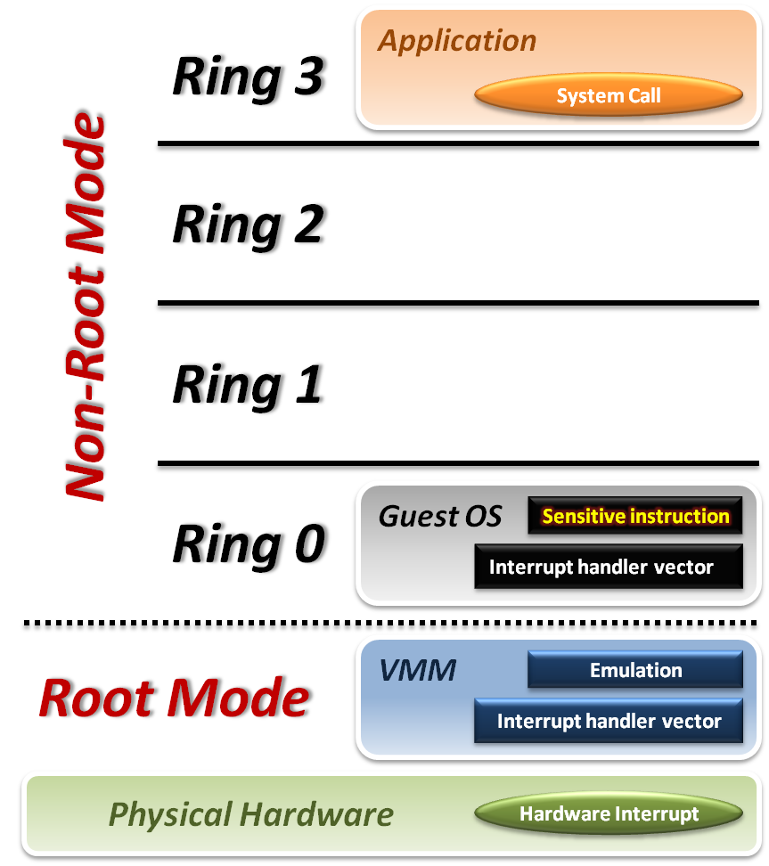





Intel VT-x
VMM with VT-x :
  System Call
    CPU will directly trap to interrupt handler vector of guest OS.
  Hardware Interrupt
    Still, hardware events need to be handled by VMM first.
  Sensitive Instruction
    Instead of trap all privilege instructions, running guest OS in Non-root mode will trap sensitive instruction only.

Slide 50
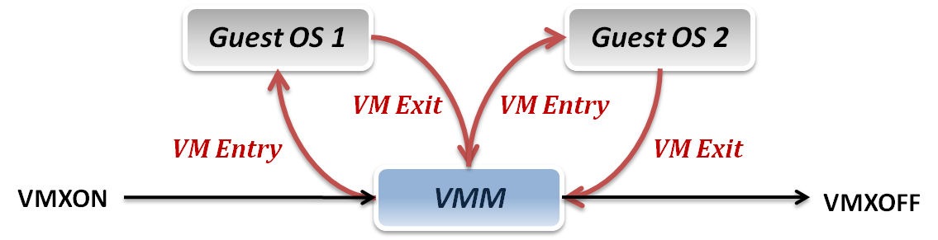
Context Switch
VMM switch different virtual machines with Intel VT-x :
  VMXON/VMXOFF
    These two instructions are used to turn on/off CPU Root Mode.
  VM Entry
    This is usually caused by the execution of VMLAUNCH/VMRESUME instructions, which will switch CPU mode from Root Mode to Non-Root Mode.
  VM Exit
    This may be caused by many reasons, such as hardware interrupts or sensitive instruction executions.
    Switch CPU mode from Non-Root Mode to Root Mode.

Slide 51
System State Management
Intel introduces a more efficient hardware approach for register switching, VMCS (Virtual Machine Control Structure) :
  State Area
    Store host OS system state when VM-Entry.
    Store guest OS system state when VM-Exit.
  Control Area
    Control instruction behaviors in Non-Root Mode.
    Control VM-Entry and VM-Exit process.
  Exit Information
    Provide the VM-Exit reason and some hardware information.
Whenever VM Entry or VM Exit occur, CPU will automatically read or write corresponding information into VMCS.

Slide 52
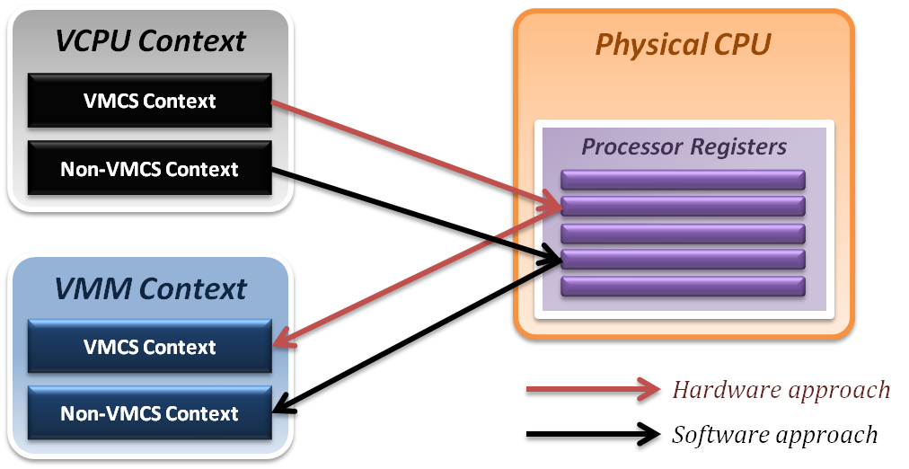
System State Management
Binding virtual machine to virtual CPU
  VCPU (Virtual CPU) contains two parts
    VMCS maintains virtual system states, which is approached by hardware.
    Non-VMCS maintains other non-essential system information, which is approach by software.
  VMM needs to handle Non-VMCS part.

Slide 53
CPU Virtualization Summary
Emulation technique
  Interpretation and binary translation approaches
  System state mapping and performance issue
    Translation chaining, Dynamic binary optimization
Virtualization technique
  Modern CPU architecture
  Trap and emulation model
  Critical instruction issue
    Para-virtualization, Dynamic binary translation
Hardware assistance
  Intel VT-x approach
    Root Mode & Non-Root Mode

Slide 54
Memory Virtualization
Shadow page table
Hardware assistance

Slide 55
Memory Virtualization
Memory management in OS
  Traditionally, OS fully controls all physical memory space and provide a continuous addressing space to each process.
  In server virtualization, VMM should make all virtual machines share the physical memory space without knowing the fact.
Goals of memory virtualization :
  Address Translation
    Control table-walking hardware that accesses translation tables in main memory.
  Memory Protection
    Define access permission which uses the Access Control Hardware.
  Access Attribute
    Define attribute and type of memory region to direct how memory operation to be handled.

Slide 56
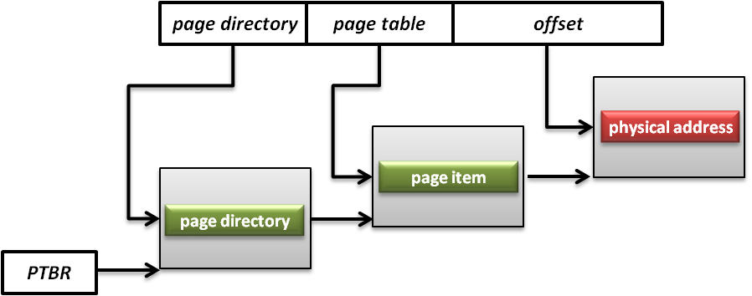
Memory Architecture
Memory Management Unit (MMU)
  What is MMU ?
    A computer hardware component responsible for handling accesses to memory requested by the CPU.
    Its functions include translation of virtual addresses to physical addresses, memory protection, cache control, bus arbitration and etc.
  What is PTBR ?
    Page Table Base Register (PTBR) is a register point to the base of page table for MMU.

Slide 57
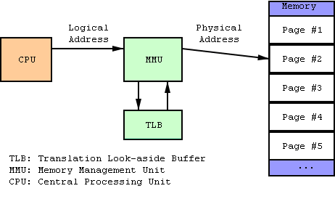
Memory Architecture
Translation Lookaside Buffer (TLB)
  What is TLB ?
    A CPU cache that memory management hardware uses to improve virtual address translation speed.

Slide 58
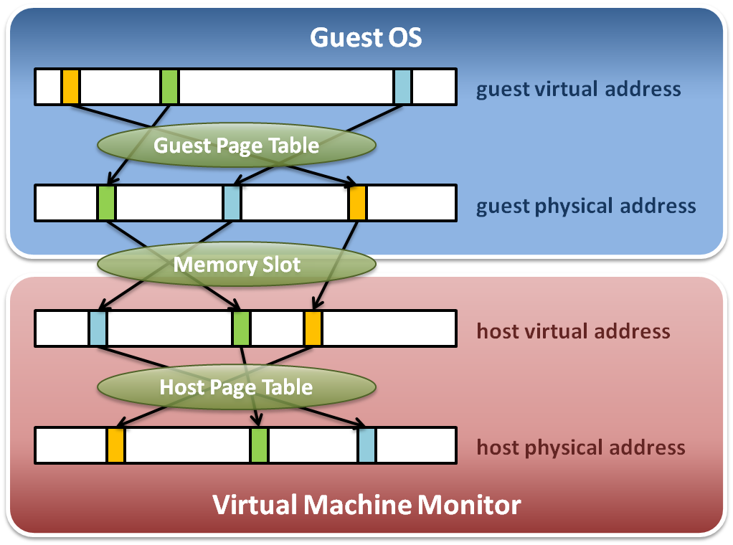
Memory Virtualization
Memory virtualization architecture

Slide 59
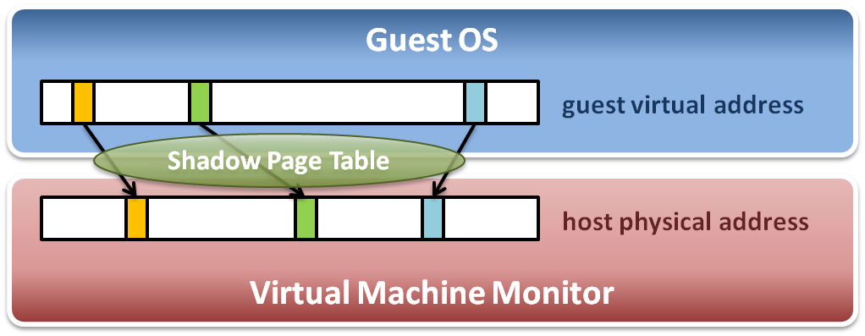
Memory Virtualization
The performance drop of memory access is usually unbearable. VMM needs further optimization.
VMM maintains shadow page tables :
  Direct virtual-to-physical address mapping
  Use hardware TLB for address translation

Slide 60
Shadow Page Table
Map guest virtual address to host physical address
  Shadow page table
    Guest OS will maintain its own virtual memory page table in the guest physical memory frames.
    For each guest physical memory frame, VMM should map it to host physical memory frame.
    Shadow page table maintains the mapping from guest virtual address to host physical address.
  Page table protection
    VMM will apply write protection to all the physical frames of guest page tables, which lead the guest page table write exception and trap to VMM.

Slide 61
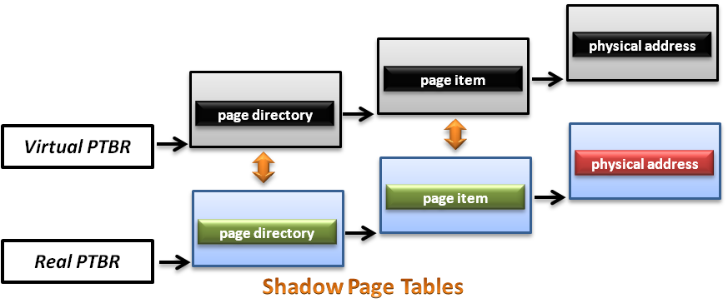
Shadow Page Table
How does this technique work ?
  VMM should make MMU virtualized
    VMM manages the real PTBR and a virtual PTBR for each VM
    When guest OS is activated, the real PTBR points to a shadow page table
    When guest OS attempts to modify the PTBR, it will be intercepted by VMM for further emulation

Slide 62
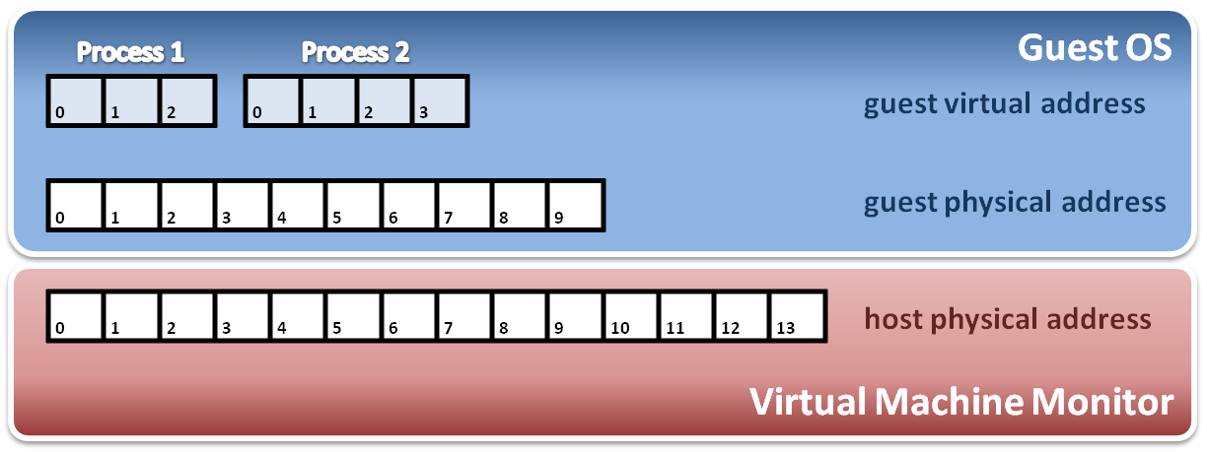
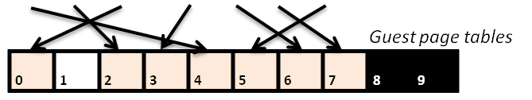
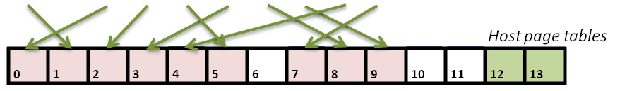
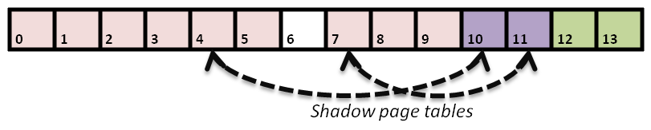
Shadow Page Table
Construct shadow page table
  Guest OS will maintain its own page table for each process.
  VMM maps each guest physical page to host physical page.
  Create shadow page tables for each guest page table.
  VMM should protect host frame which contains guest page table.
Write protection

Slide 63
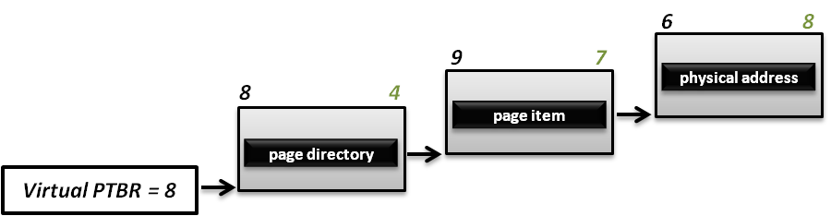
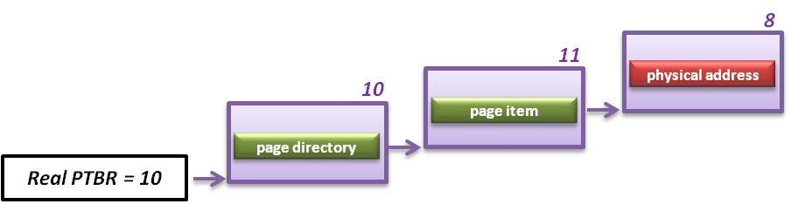
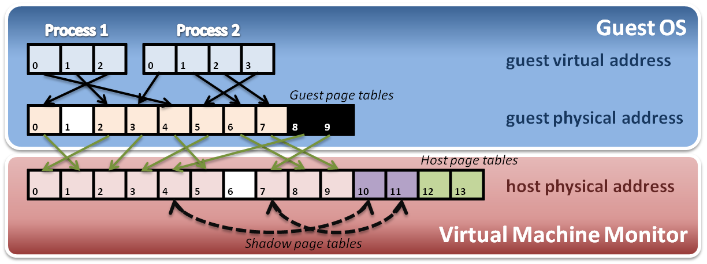
Shadow Page Table
Implement with PTBR :
  For example, process 2 in guest OS want to access its memory whose page number is 1.

Slide 64
Shadow Page Table
Shadow page table operations :
Context switch
New process
Access
Process
Page Table
Process
Page Table
Process
Page Table
Virtual PTPR
Guest OS
Real PTPR
VMM
Page fault !
Shadow
Page Table
Shadow
Page Table
Shadow
Page Table
Load !
Corresponding mapping table
Switch the pointer to new location
Create new shadow page table mapping to new process

Slide 65
Other Issues
Page fault and page protection issue
  When a physical page fault occurs, VMM need to decide whether this exception should be injected to guest OS or not.
    If the page entry in the page table of guest OS is still valid, VMM should prepare the corresponding page and not inject any exception to guest OS.
    If the page entry in the page table of guest Os is invalid either, then VMM should directly inject the virtual page fault to guest OS.
  When guest OS want to modify its page tables, VMM need to intercept this operation.
    When guest OS reload PTBR, CPU will trap to VMM due to the Ring Compression nature.
    VMM will walk the page table of guest OS and modify the related shadow page table to make MMU get host physical address.

Slide 66
Memory Virtualization
Shadow page table
Hardware assistance

Slide 67
Hardware Solution
Difficulties of shadow page table technique :
  Shadow page table implementation is extremely complex.
  Page fault mechanism and synchronization issues are critical.
  Host memory space overhead is considerable.
But why we need this technique to virtualize MMU ?
  MMU do not first implemented for virtualization.
  MMU is knowing nothing about two level page address translation.
Now, let us consider hardware solution.

Slide 68
Extended Page Table
Concept of Extended Page Table (EPT) :
  Instead of walking along with only one page table hierarchy, EPT technique implement one more page table hierarchy.
    One page table is maintained by guest OS, which is used to generate guest physical address.
    The other page table is maintained by VMM, which is used to map guest physical address to host physical address.
  For each memory access operation, EPT MMU will directly get guest physical address from guest page table, and then get host physical address by the VMM mapping table automatically.

Slide 69
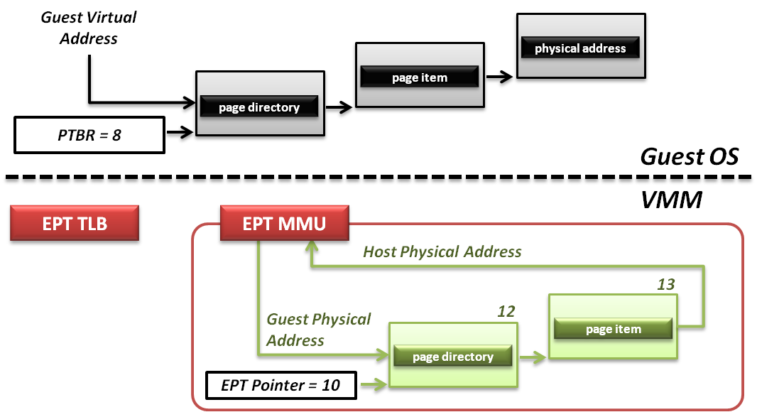
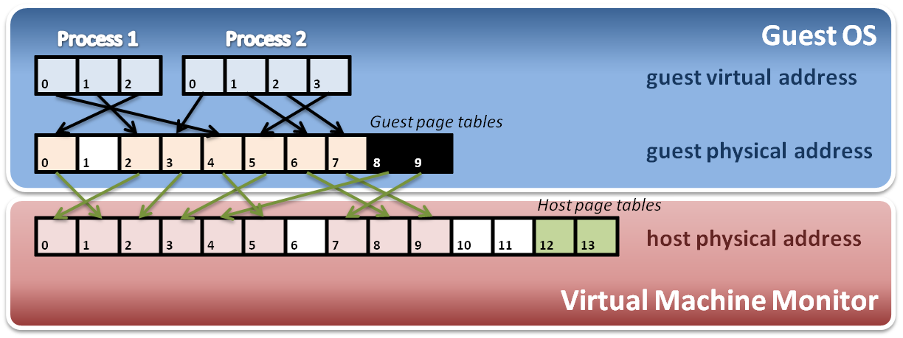
Extended Page Table
Memory operation :
6
8
9
7
8
4
Data

Slide 70
Memory Virtualization Summary
Software implementation
  Memory architecture
    MMU (memory management unit)
    TLB (translation lookaside buffer)
  Shadow page table
    MMU virtualization by virtual PTBR
    Shadow page table construction
    Page fault and page table protection
Hardware assistance
  Extended page table
    Hardware walk guest and host page table simultaneously

Slide 71
IO Virtualization
Overview
Device Model
Hardware Assistance

Slide 72
IO Virtualization
Goal :
  Share or create IO devices for virtual machines.
Two types of IO subsystem architecture :
  Port Mapped IO
    Port-mapped IO uses a special class of CPU instructions specifically for performing IO.
  Memory Mapped IO (MMIO)
    Memory Mapped IO uses the same address bus to address both memory and IO devices, and the CPU instructions used to access the memory are also used for accessing devices.
Traditional IO techniques :
  Direct memory Access (DMA)
  PCI / PCI Express

Slide 73
Port Mapped IO
IO devices are mapped into a separate address space
  IO devices have a separate address space from general memory, either accomplished by an extra “IO" pin on the CPU's physical interface, or an entire bus dedicated to IO.
  Generally found on Intel microprocessors, specifically the IN and OUT instructions which can read and write one to four bytes (outb, outw, outl) to an IO device.
Pros & Cons
  Pros
    Less logic is needed to decode a discrete address.
    Benefits for CPUs with limited addressing capability.
  Cons
    More instructions are required to accomplish the same task.
    IO addressing space size is not flexible.

Slide 74
Memory Mapped IO
IO devices are mapped into the system memory map along with RAM and ROM.
  To access a hardware device, simply read or write to those 'special' addresses using the normal memory access instructions.
Pros & Cons
  Pros
    Instructions which can access memory can be used to operate an IO device.
    Operate on the data with fewer instructions.
  Cons
    Physical memory addressing space must be shared with IO devices.
    The entire address bus must be fully decoded for every device.

Slide 75
Direct Memory Access
What is DMA ?
  Allow certain hardware subsystems within the computer to access system memory for reading and/or writing independently of the central processing unit.
Two types of DMA :
  Synchronous DMA
    The DMA operation is caused by software.
    For example, sound card driver may trigger DMA operation to play music.
  Asynchronous DMA
    The DMA operation is caused by devices (hardware).
    For example, network card use DMA operation to load data into memory and interrupt CPU for further manipulation.

Slide 76
PCI & PCI Express
What is PCI ?
  PCI (Peripheral Component Interconnect) is a computer bus for attaching hardware devices.
  Typical PCI cards used include :
    Network cards, sound cards, modems
    Extra ports such as USB or serial, TV tuner cards and disk controllers.
What is PCI Express ?
  PCIe is a computer expansion card standard designed to replace the older PCI, PCI-X, and AGP standards.
  Its topology is based on point-to-point serial links, rather than a shared parallel bus architecture.

Slide 77
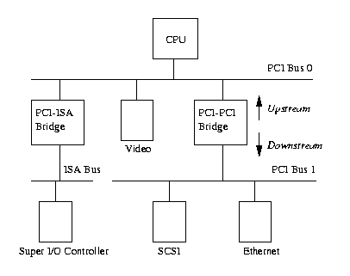
PCI & PCI Express
PCI based system build in a tree topology
  PCI bus
    Parallel connect devices and bridges
  PCI-PCI Bridge
    Connect two PCI buses
    Become the root of lower bus
  PCI-ISA Bridge
    Connect to conventional ISA device

Slide 78
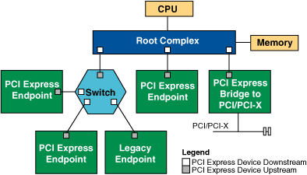
PCI & PCI Express
PCIe based system build in a point to point architecture
  Root Complex
    Similar to a host bridge in a PCI system, the root complex generates transaction requests on behalf of the processor, which is interconnected through a local bus.
  Switch
    Connect endpoint devices or other switches
  Endpoint Device
    Physical PCIe devices
    Legacy PCI devices
  PCI Express Bridge
    Connect to other legacy
    subsystems

Slide 79
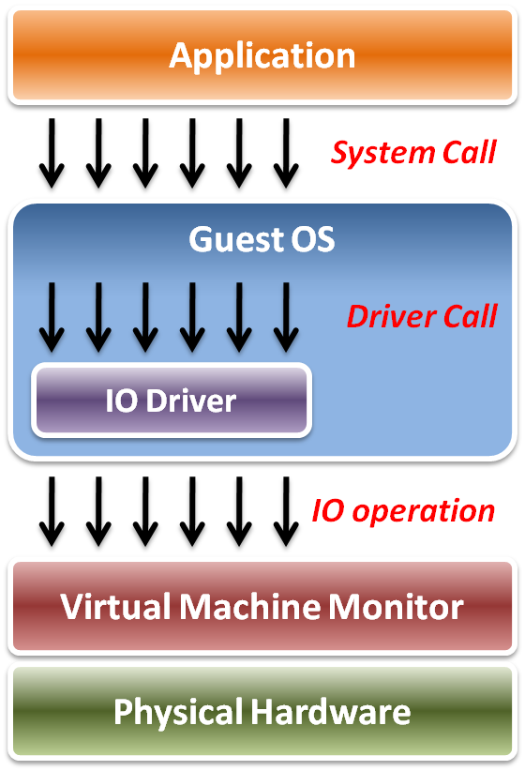
IO Virtualization
Implementation Layers :
  System call
    The interface between applications and guest OS.
  Driver call
    The interface between guest OS and IO device drivers.
  IO operation
    The interface between IO device driver of guest OS and virtualized hardware ( in VMM ).

Slide 80
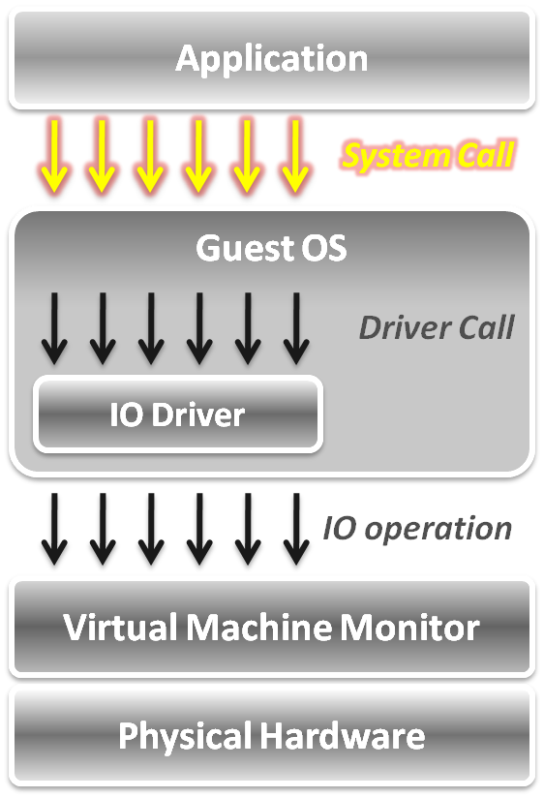
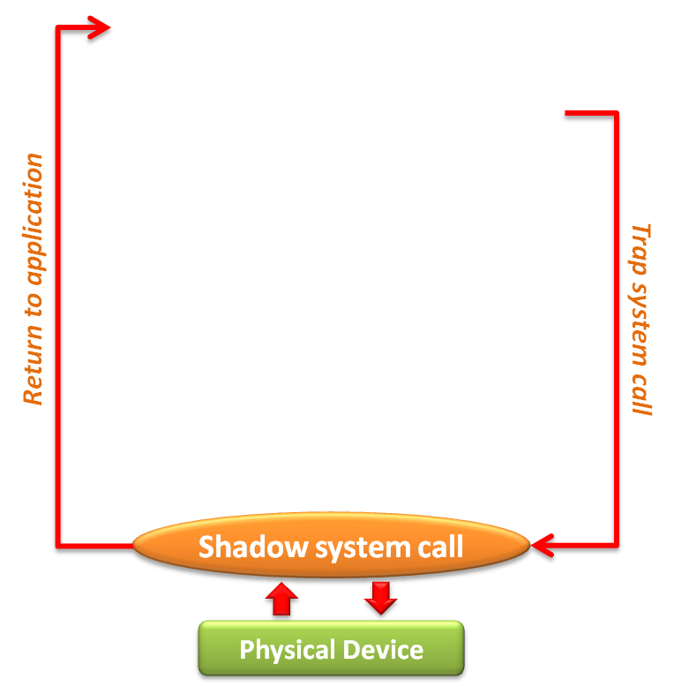
IO Virtualization
In system call level :
  When an application invokes a system call, the system call will be trapped to VMM first.
  VMM intercepts system calls, and maintains shadowed IO system call routines to simulate functionalities.
  After simulation, the control goes back to the application in gust OS.

Slide 81
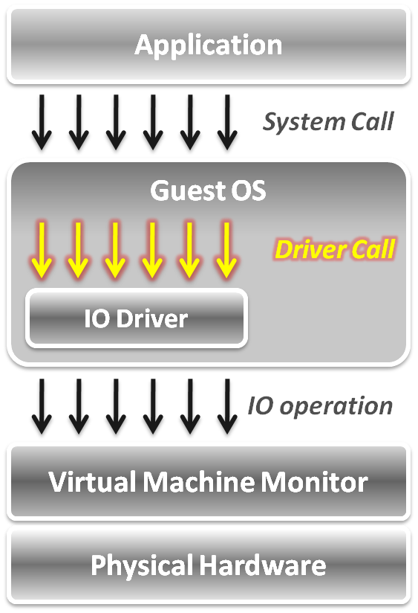
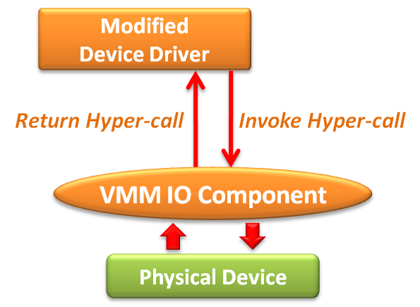
IO Virtualization
In device driver call level :
  Adopt the para-virtualization technique, which means the IO device driver in guest OS should be modified.
  The IO operation is invoked by means of hyper-call between the modified device driver and VMM IO component.

Slide 82
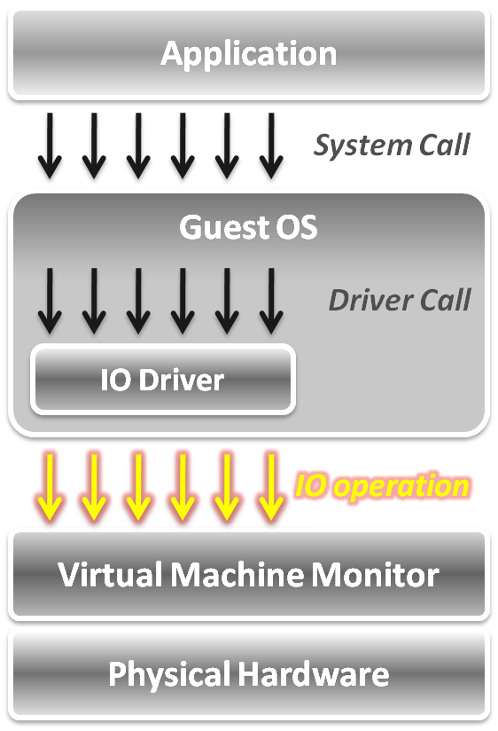
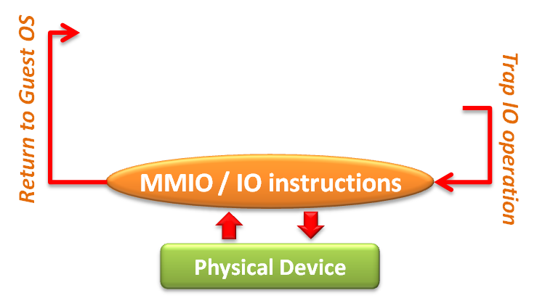
IO Virtualization
In IO operation level,
two approaches :
  Memory mapped IO
    Loads/stores to specific region of real memory are interpreted as command to devices.
    The memory mapped IO region is protected.
  Port mapped IO
    Special input/output instructions with special addresses.
    The IO instructions are privileged .
Due to the privileged nature, these IO operations will be trapped to the VMM.

Slide 83
IO Virtualization
Overview
Device Model
Hardware Assistance

Slide 84
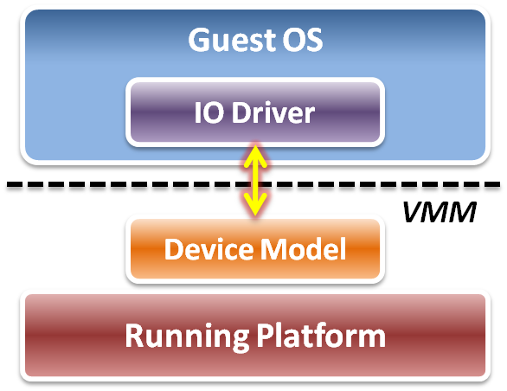
Device Model
Focus on IO operation level implementation.
  This is an approach of full virtualization.
Logic relation between guest OS and VMM :
  VMM intercepts IO operations from guest OS.
  Pass these operations to device model on a running platform.
  Device model needs to emulate
  the IO operation interfaces.
    Port mapped IO
    Memory mapped IO
    DMA
    ... etc.

Slide 85
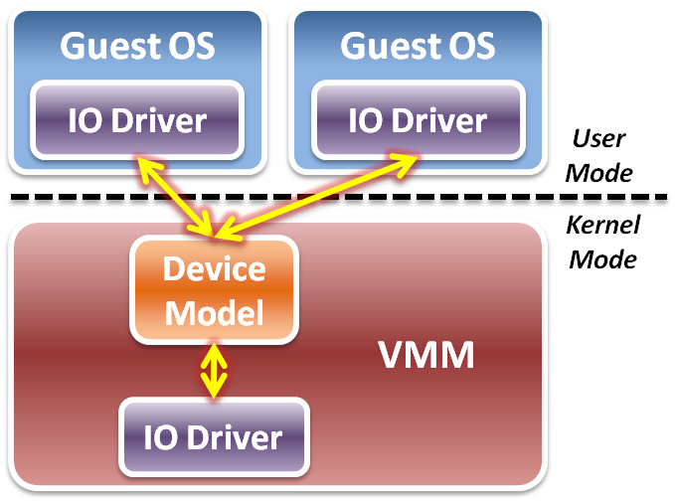
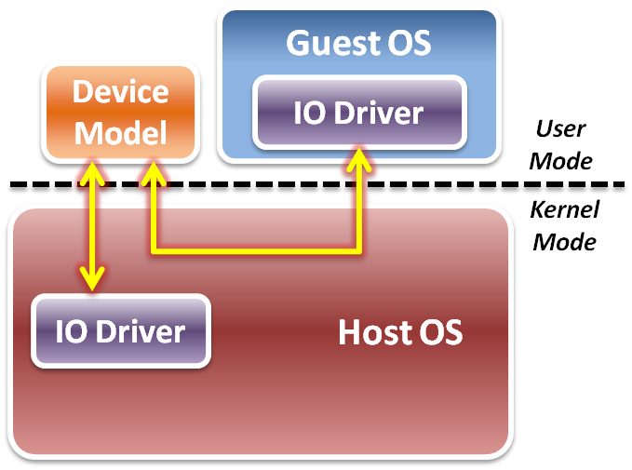
Device Model
Two different implementations of device model :
  Device model is implemented as part of VMM.
  Device model is running in user space as a stand alone service.
Type 1 Virtualization
Type 2 Virtualization

Slide 86
Device Model
IO virtualization flow
  Initialization – device discovery
    VMM will make guest OS discover the virtualized IO devices.
    Then guest OS will load the corresponding device driver.
  Operation – access interception
    When guest OS executes IO operations, VMM will intercept those accesses.
    After virtual device operations, VMM returns the control to guest OS.
  Virtualization – device virtualization
    Device model should emulate the real electronic logic to satisfy all device interface definition and its effects.
    VMM may share physical devices to all virtual machines.

Slide 87
Device Discovery
Virtualize physical bus devices
  Non-enumerable physical device
    These devices have their own hard-coded numbers.
    VMM should setup some status information on the virtual device ports.
    For example, PS/2 keyboard and mouse.
  Enumerable physical device
    These devices defined a complete device discover method.
    VMM have to emulate not only the device itself, but the bus behavior.
    For example, PCI or PCI express devices.
Virtualize non-exist devices
  VMM must define and emulate all functions of these devices
    VMM may define them as either non-enumerable or enumerable devices.
    Guest OS needs to load some new drivers of these virtual devices.

Slide 88
Access Interception
After virtual device discovered by guest OS, VMM has to intercept and control all the IO operations from guest OS.
Port mapped IO operation
  Direct device assignment
    VMM should turn ON the physical IO bitmap.
    All the IO instructions (IN/OUT) from guest OS will be directly performed onto hardware without VMM intervention.
  Indirect device assignment
    VMM should turn OFF the physical IO bitmap.
    All the IO instructions from guest OS will be intercepted by VMM and forward to physical hardware.

Slide 89
Access Interception
Memory mapped IO operation
  Direct device assignment
    VMM should use the shadow page table to map IO device addressing space of guest OS to the space of host.
    Then all the IO operations from guest OS will not be intercepted.
  Indirect device assignment
    VMM should make the all entries of the IO device addressing space in the shadow page table to be invalid.
    When guest OS access those addressing space, it will introduce the page fault which trap CPU to VMM for device emulation.
DMA mechanism
  Address remapping
    Because the device driver in the guest OS does not know the host physical address, VMM needs to remap the DMA target automatically when intercepting guest OS.

Slide 90
Device Virtualization
IO device types :
  Dedicated device
    Ex : displayer, mouse, keyboard …etc.
  Partitioned device
    Ex : disk, tape …etc
  Shared device
    Ex : network card, graphic card …etc.
  Nonexistent physical device
    Ex : virtual device …etc.

Slide 91
Device Virtualization
Dedicated device
  Do not necessarily have to be virtualized.
  In theory, requests of such device could bypass the VMM.
  However, they are handled by the VMM first since OS is running in user mode.
Partitioned device
  Be partitioned into several smaller virtual devices as dedicated to VM.
  VMM translates address spaces to those of the physical devices.

Slide 92
Device Virtualization
Shared device
  Should be shared among VMs.
  Each VM has its own virtual device state.
  VMM translates requests from a VM to physical device .
Nonexistent physical device
  Virtual device “attached” to a VM for which there is no corresponding physical device.
  VMM intercepts requests from a VM, buffers it and interrupts other VMs.

Slide 93
Performance Issues
When considering performance, two major problems :
  How to make guest OS directly access IO addresses ?
    Other than software approaches discussed above, we can make use of the hardware assistance (Intel EPT technique in memory virtualization) to map IO addresses from host to guest directly without software overhead.
  How to make DMA directly access memory space in guest OS ?
    For the synchronous DMA operation, guest OS will be able to assign the correct host physical memory address by EPT technique.
    For the asynchronous DMA operation, hardware must access memory from host OS which will introduce the VMM intervention.

Slide 94
IO Virtualization
Overview
Device Model
Hardware Assistance

Slide 95
Hardware Solution
Difficulty :
  Software cannot make data access directly from devices.
Tow hardware solutions :
  Implement DMA remapping in hardware
    Remap DMA operations automatically by hardware.
    For example, Intel VT-d .
  Specify IO virtualization standards of PCI Express devices
    Implement virtualizable device with PCI Express interface.
    For example, SR-IOV or MR-IOV.

Slide 96


Intel VT-d
Add DMA remapping hardware component.
Software Approach
Hardware Approach

Slide 97

IO Virtualization Progress
Software based sharing
  Implement virtualization
  by VMM software stack.
  Advantage
    Full virtualization without
    special hardware support.
  Disadvantage
    Significant CPU overhead
    may be required by the
    VMM.

Slide 98

IO Virtualization Progress
Hardware direct assignment
  Implement virtualization
  with Intel VT-x and VT-d
  supports.
  Advantage
    Data access bypass VMM.
    Improve IO performance.
  Disadvantage
    Dedicate physical device
    assignment limit the system
    scalability.

Slide 99

IO Virtualization Progress
New industrial standard
  Instead of implementing virtualization in CPU or memory only, industry com up with new IO virtualization standard in PCI Express devices.
  Advantages
    Fully collaboration with
    physical hardware devices.
    Improve system scalability.
    Improve system agility.
  Disadvantages
    IO devices must implement
    with new specification.

Slide 100
Single Root – IO Virtualization
What is SR-IOV ?
  The PCI-SIG Single Root I/O Virtualization and Sharing (SR-IOV) specification defines a standardized mechanism to create natively shared devices.
Basic components :
  Physical Functions (PFs):
    These are full PCIe functions that include the SR-IOV Extended Capability.
    The capability is used to configure and manage the SR-IOV functionality.
  Virtual Functions (VFs):
    These are “lightweight” PCIe functions that contain the resources necessary for data movement but have a carefully minimized set of configuration resources.

Slide 101

Single Root – IO Virtualization
SR-IOV works with VMM :
  VMM
    An SR-IOV-capable device
    can be configured to appear
    in the PCI configuration
    space as multiple functions.
  VM
    The VMM assigns one or
    more VFs to a VM by
    mapping the actual
    configuration space the VFs
    to the configuration space
    presented to the virtual
    machine by the VMM.

Slide 102
IO Virtualization Summary
IO subsystem architecture
  Port Mapped IO vs. Memory Mapped IO
  Direct Memory Access (DMA)
  PCI / PCI Express
IO virtualization
  Three implementation layers
  IO virtualization paradigm with device model
Hardware assistance
  DMA remapping hardware
  Single Root – IO Virtualization specification

Slide 103
Ecosystem
VMware , Xen , KVM

Slide 104
Venders and Projects
Virtual machine venders :
  VMware
    The company was founded in 1998 and is based in Palo Alto, California. The company is majority owned by EMC Corporation.
    Implement both type-1 and type-2 VM.
  Xen
    First developed in University of Cambridge Computer Laboratory.
    As of 2010 the Xen community develops and maintains Xen as free software, licensed under the GNU General Public License (GPLv2).
    Implement para-virtualization.
Virtual machine project :
  KVM ( Kernel-based Virtual Machine )
    A Linux kernel virtualization infrastructure.
    As of 2010, KVM supports native virtualization using Intel VT-x or AMD-V.

Slide 105

VMware
Basic properties :
  Separate OS and hardware –
  break hardware dependencies
  OS and Application as single unit by encapsulation
  Strong fault and security isolation
  Standard, HW independent environments can be provisioned anywhere
  Flexibility to chose the right OS for the right application

Slide 106

VMware Virtualization Stack

Slide 107
VMware Major Products
VMware GSX Server
  Run multiple servers on your server
  Hosted Architecture
  Available for Linux hosts and Windows hosts
VMware ESX Server
  Quality of Service
  High-performance I/O
  Host-less Architecture ( bare-metal )

Slide 108

VMware GSX Server Architecture

Slide 109

VMware ESX Server Architecture

Slide 110
Xen
Basic properties :
  Para-virtualization
    Achieve high performance even on its host architecture (x86) which has a reputation for non-cooperation with traditional virtualization techniques.
  Hardware assisted virtualization
    Both Intel and AMD have contributed modifications to Xen to support their respective Intel VT-x and AMD-V architecture extensions.
  Live migration
    The LAN iteratively copies the memory of the virtual machine to the destination without stopping its execution.
Implement system:
  Novell's SUSE Linux Enterprise 10
  Red Hat's RHEL 5
  Sun Microsystems' Solaris

Slide 111
Para-virtualization in Xen
Xen extensions to x86 arch
  Like x86, but Xen invoked for privileged instructions
  Avoids binary rewriting
  Minimize number of privilege transitions into Xen
  Modifications relatively simple and self-contained
Modify kernel to understand virtualized environment
  Wall-clock time vs. virtual processor time
    Desire both types of alarm timer
  Expose real resource availability
    Enables OS to optimize its own behaviour

Slide 112

Original Xen Architecture

Slide 113
Hardware Assistance in Xen
Hardware assistance :
  CPU provides VMExit for certain privileged instructions
  Extend page tables used to virtualize memory
Xen features :
  Enable Guest OS to be run without modification
    For example, legacy Linux and Windows
  Provide simple platform emulation
    BIOS, apic, iopaic, rtc, Net (pcnet32), IDE emulation
  Install para-virtualized drivers after booting for high-performance IO
  Possibility for CPU and memory para-virtualization
    Non-invasive hypervisor hints from OS

Slide 114

New Xen Architecture

Slide 115
KVM
KVM ( Kernel-based Virtual Machine)
  Linux host OS
    The kernel component of KVM is included in mainline Linux, as of 2.6.20.
  Full-virtualization
    KVM is a full virtualization solution for Linux on x86 hardware containing virtualization extensions (Intel VT or AMD-V).
    Using KVM, one can run multiple virtual machines running unmodified Linux or Windows images.
  IO device model in KVM :
    KVM requires a modified QEMU for IO virtualization framework.
    Improve IO performance by virtio para-virtualization framework.

Slide 116

KVM Full Virtualization
It consists of a loadable kernel module
  kvm.ko
    provides the core virtualization infrastructure
  kvm-intel.ko / kvm-amd.ko
    processor specific modules

Slide 117

IO Device Model in KVM
Original approach with full-virtualization
  Guest hardware accesses are
  intercepted by KVM
  QEMU emulates hardware behavior
  of common devices
    RTL 8139
    PIIX4 IDE
    Cirrus Logic VGA

Slide 118

IO Device Model in KVM
New approach with para-virtualization

Slide 119

IO Device Model in KVM
virtio architecture

Slide 120
Other Issues
Live migration
Cloud properties

Slide 121
Other Issues
Essential technique of cloud properties implementation
  Live migration of virtual machines
    Migrate a virtual machine from one physical machine to another in the run time with a small amount of performance down grade.
Virtualization enabled cloud properties :
  Scalability
    Virtual machine system automatic scale up
  Availability
    Fault tolerant of hardware and software
  Manageability
    Automatic physical to virtual system transformation
  Performance
    Dynamically virtual machine level load balancing

Slide 122

Live Migration Technique
Pre-assumption :
  We assume that all storage resources are
  separated from computing resources.
  Storage devices of VMs are attached from
  network :
    NAS: NFS, CIFS
    SAN: Fibre Channel
    iSCSI, network block device
    drdb network RAID
  Require high quality network connection
    Common L2 network (LAN)
    L3 re-routing
VM 1
VM 2
VM 2
Disk
VM 1
Disk

Slide 123

Live Migration Technique
Challenges of live migration :
  VMs have lots of state in memory
  Some VMs have soft real-time
  requirements :
    For examples, web servers,
    databases and game servers, ...etc.
    Need to minimize down-time
Relocation strategy :
  Pre-migration process
  Reservation process
  Iterative pre-copy
  Stop and copy
  Commitment

Slide 124

Live Migration Technique
Pre-migration process
Reservation process
VM active on host A
Destination host selected
(Block devices mirrored)
Initialize container on target host
Copy dirty pages in successive rounds
Suspend VM on host A
Redirect network traffic
Synch remaining state
Activate on host B
VM state on host A released
Iterative pre-copy
Stop and copy
Commitment

Slide 125
Live Migration Technique
Live migration process :
Pre-copy migration : Round 1
Host A
Host B

Slide 126
Live Migration Technique
Live migration process :
Pre-copy migration : Round 2
Host A
Host B

Slide 127
Live Migration Technique
Live migration process :
Stop and copy : Final Round
Host A
Host B

Slide 128




Scalability in Virtualization
Scalability implement by VMware:
  VMware VMotion, makes it possible to move Virtual Machines, without interrupting the applications running inside.
  Dynamically scale up virtual machine system among physical servers.

Slide 129
Availability in Virtualization
Fault tolerance system :
  VMware makes all Servers and Applications protected against component and complete system failure.
  When system failure occurs, virtual machines will be automatic restarted on other physical servers.
X

Slide 130
Availability in Virtualization
Disaster recovery :
  VMware Site Recovery Manager enables an easy transition from a production site to a Disaster Recovery site.
  Easy Execution for real Disaster
  Easy Testing for good night sleep
X

Slide 131


Availability in Virtualization
Fail over technique
Backup VM
Backup VM
X
Application protection against hardware failures, with NO down time that is Application and Operating System Independent.

Slide 132
Manageability in Virtualization
Provide physical to virtual translation :
  Consolidation Management with the VMware Infrastructure software will automate the migration from physical to virtual machines.

Slide 133
Performance in Virtualization
Dynamic load balancing :
  VMware Distributed Resource Scheduler automatically balances the Workloads according to set limits and guarantees.
  Removing the need to predict resource assignment.

Slide 134

Performance in Virtualization
Optimize network access :
  VMware and Cisco are collaborating to enhance workload mobility and simpler management with virtualization-aware networks.
Nexus 1000V

Slide 135







Security in Virtualization
Enhance virtual machine security protection :
  The Application vService VMSafe allows security vendors to add superior security solutions inside the VMware Infrastructure.

Slide 136

Summary
Server virtualization technique :
  CPU virtualization
    Ring compression, Intel VT-x, …etc
  Memory virtualization
    Shadow page table, Intel EPT, …etc
  IO virtualization
    Device model, Intel VT-d, PCIe SR-IOV, …etc
Ecosystem :
  VMware implements both type-1 & type-2 virtualization
  Xen implements both para and full virtualization
  KVM implements in Linux mainstream kernel
Cloud properties :
  Enabled by live migration technique
  Scalability, Availability, Manageability and Performance

Slide 137
References
Books :
  James E. Smith & Ravi Nair, Virtual Machines, Elsevier Inc., 2005
  英特爾開源軟件技術中心 & 復旦大學並行處理研究所, 系統虛擬化 – 原理與實現, 北京 : 清華大學出版社, 2009.03
Web resources :
  Xen project http://www.xen.org
  KVM project http://www.linux-kvm.org/page/Main_Page
  IBM VirtIO survey https://www.ibm.com/developerworks/linux/library/l-virtio
  PCI-SIG IO virtualization specification http://www.pcisig.com/specifications/iov
Other resources :
  Lecture slides of “Virtual Machine” course (5200) in NCTU
  Vmware Overview Openline presentation slides http://www.openline.nl
  Xen presentation http://www.cl.cam.ac.uk/research/srg/netos/papers/2006-xen-fosdem.ppt

